Slide 1
GL IIITH Hackathon House Price Prediction
Group 23
R Venkat Raghavendra Rao
Bharat Surana

Slide 2
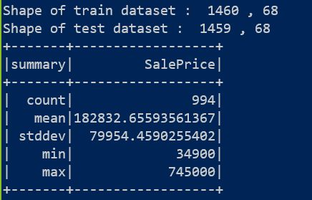
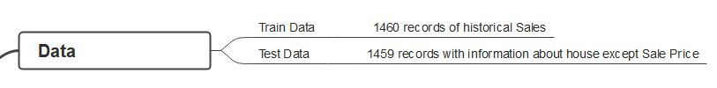
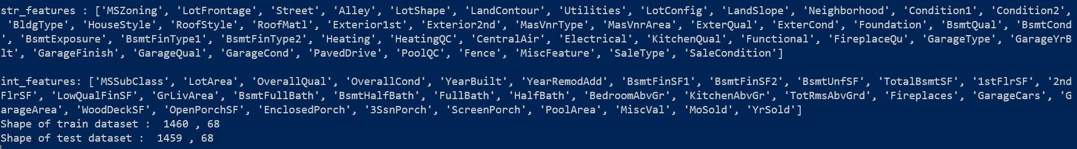
Problem Statement Predict the house sale price based on the historical sales pattern
Even though this dataset is not big, the expectation is to build a model for a big data problem

Slide 3
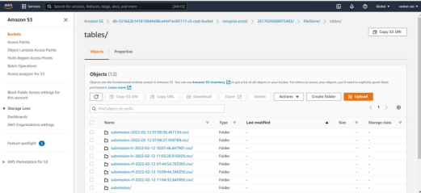
Platform / Tools Used
AWS S3 Instance to store data

Slide 4
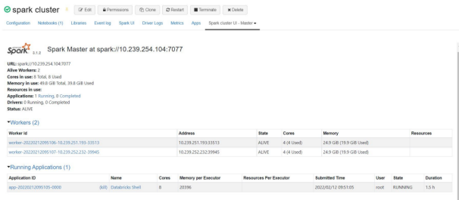
Platform / Tools Used
Spark Cluster

Slide 5
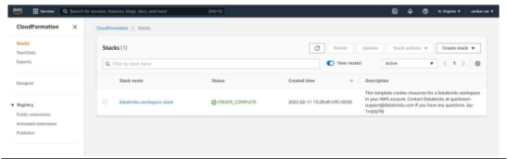
Platform / Tools Used
Databricks: To develop and mange python application

Slide 6
Architecture and High-level flow
AWS S3
Spark Compute (In Memory)
Data bricks
Git Hub
Docker Hub
House Sales Historical Data
Spark Cluster
Data Analysis
Source Code
Application Image
ML Model Development
AI / ML Pipeline
Predictions

Slide 7
ML Solution Development
Load Pre-requisite libraries: Pyspark, Pandas, numpy, matplotlib, seaborn etc.
Create Spark session
Load the data using pyspark
ELT (Extract, Load Transform)
Exploratory Data Analysis
Feature Scaling
Feature Extraction
Pyspark Pipeline Development
Pickle file
Generating Predictions in batch
Model versioning
ML Ops

Slide 8
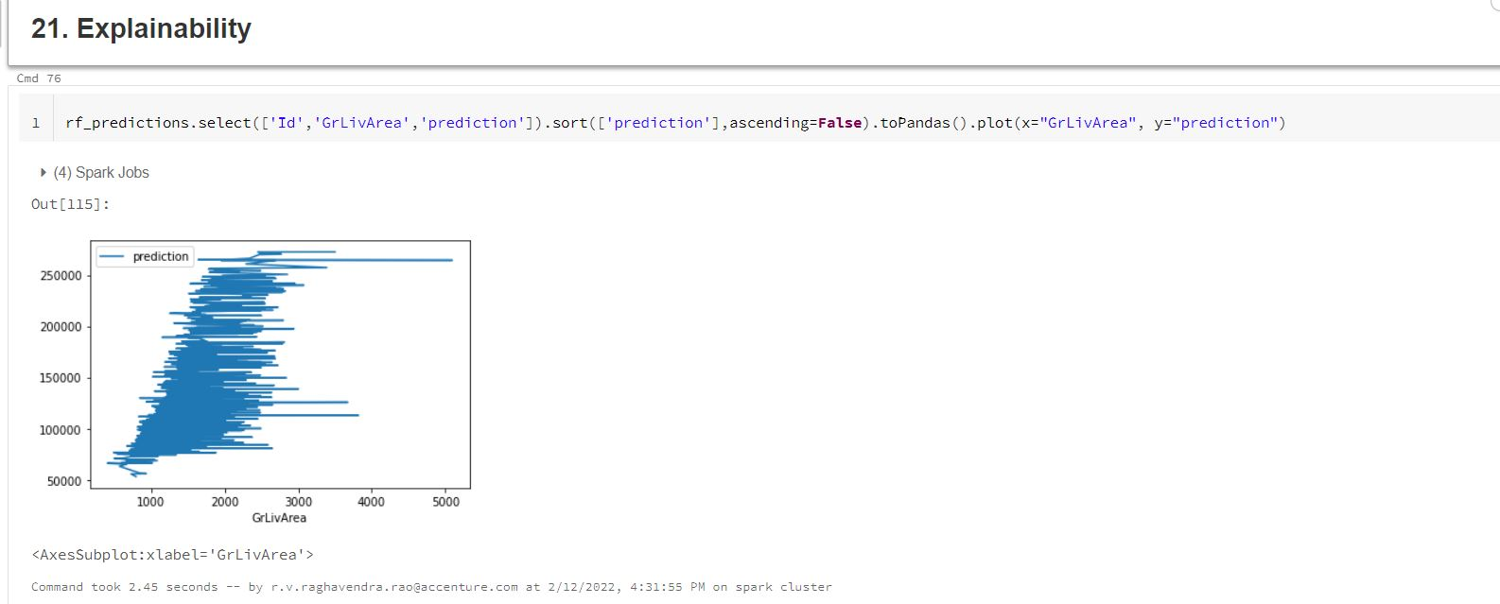
Explanability

Slide 9
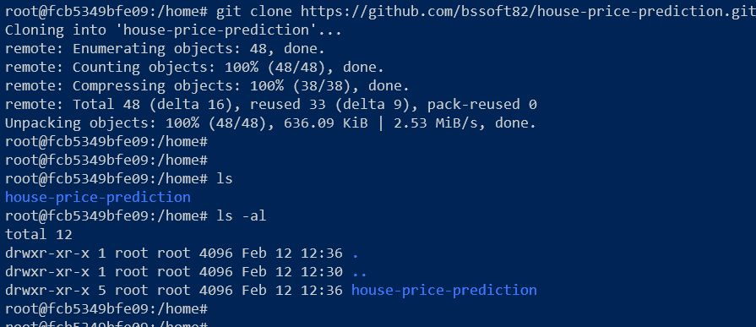
Git Repository downloaded in Docker container
GIT Repo: https://github.com/bssoft82/house-price-prediction.git

Slide 10
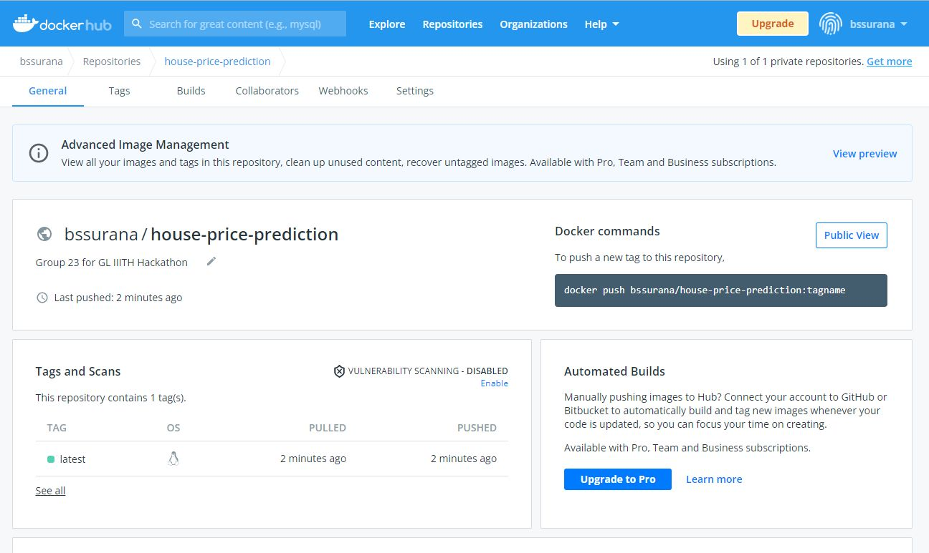
Docker hub repository
docker push bssurana/house-price-prediction:latest

